Slide 1
Chemistry – Week of 4/6, 2020 #1
Objective –
Types of Reactions
Predicting Products
Assignment:
Complete typing instructions for first balancing reactions worksheet
Complete the Predicting Products WS
Agenda
5 types of reactions
Predicting Products by type

Slide 2
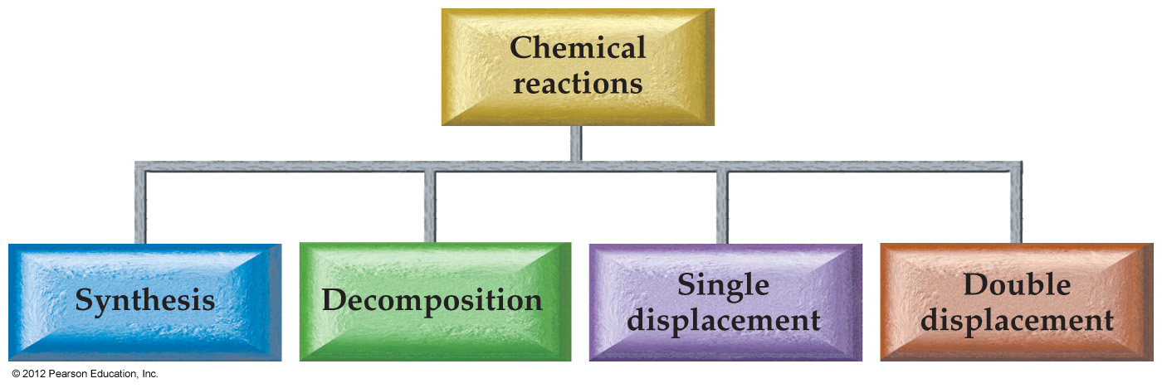
Types of reactions
Synthesis (Combination)
A + B → AB Two elements react to form a compound
Decomposition
AB → A + B A compound is separated into its elements
Single Replacement
A + BC → AC + B One element takes the place of another in a compound.
Double Replacement
AB + CD → AD + CB Ionic partners switch

Slide 3
Combustion
The reaction with oxygen is so common that it is often given its own classification: combustion.
The products of a combustion are always the oxides of the elements in the other reactant. If there is a choice of metal ion, you will be told what ion charge to use.
Ex: Fe + O₂ → Fe₂O₃
Ex: CH₄ + O₂ → CO₂ + H₂O
Ex: Li + O₂ → Li₂O
Classify each of the reactions
on the next slide.

Slide 4
Type ID practice
_____ H₂ + _____ O₂ → _____ H₂O
_____ Fe + _____ Cl₂ → _____ FeCl₃
_____ Cu + _____ AgNO₃ → _____ Cu(NO₃)₂ + _____ Ag
_____ Zn + _____ HCl → _____ ZnCl₂ + _____ H₂
_____ Pb(NO₃)₂ + _____ AlCl₃ → _____ PbCl₂ + _____ Al (NO₃)₃
_____ LiClO₃ → _____ LiCl + _____ O₂
_____ Mg(OH)₂ + _____ HCl → _____ MgCl₂ + _____ H₂O

Slide 5
Type ID practice Answers
__2__ H₂ + __1__ O₂ → __2__ H₂O
__2__ Fe + __3__ Cl₂ → __2__ FeCl₃
__1__ Cu + __2__ AgNO₃ → __1__ Cu(NO₃)₂ + __2__ Ag
__1__ Zn + __2__ HCl → __1__ ZnCl₂ + __1__ H₂
__3__ Pb(NO₃)₂ + __2__ AlCl₃ → ___3_ PbCl₂ + __2__ Al (NO₃)₃
__2__ LiClO₃ → __2__ LiCl + __3__ O₂
__1__ Mg(OH)₂ + __2__ HCl → __1__ MgCl₂ + __2__ H₂O

Slide 6
Predicting Products
If given reactants, you should be able to predict the products.
The type of reactants will tell you which type of reaction will happen.
Reactants | Reaction Type | Products
Two elements | Synthesis (S) | Compound of the two elements
A single compound | Decomposition (D) | Component elements (or simpler substances)
An element and a compound | Single replacement (SR) | Different element and compound
Two compounds | Double replacement (DR) | Two different compounds
Reaction with oxygen | Combustion (C) | Oxides of each element in other reactant

Slide 7
Predicting Synthesis
Use when there are two elemental reactants there will be only one product
Determine the ions each element makes. One will be a cation, the other will be an anion.
If a variable charge element is involved you will need to be told what ion charge is appropriate for the product.
Use the “switch drop and reduce” procedure to determine the formula of the single product.

Slide 8
Predicting Synthesis
Recall nonmetals and nonmetal oxides react with water to form acids and metals and metal oxides react with water to form bases (hydroxides)
Sometimes a simple inventory of the atoms reacting will suggest a product.
Balance the reaction.
Ex: (II) Ni + Cl₂ →
Ex: N₂O₅ + H₂O →

Slide 9
Predicting Decomposition
Use when there is only one reactant.
Decompositions follow patterns: (These patterns will be on the test)
binary compound → two elements
metal carbonate → metal oxide + carbon dioxide
metal hydrogen carbonate → metal oxide + water + carbon dioxide
metal hydroxide → metal oxide + water
metal chlorate → metal chloride + oxygen
metal sulfate → metal oxide + sulfur dioxide + oxygen
metal nitrate → metal oxide + nitrogen dioxide + oxygen

Slide 10
Predicting Decomposition -Practice
binary compound → two elements
metal carbonate → metal oxide + carbon dioxide
metal hydrogen carbonate → metal oxide + water + carbon dioxide
metal hydroxide → metal oxide + water
metal chlorate → metal chloride + oxygen
metal sulfate → metal oxide + sulfur dioxide + oxygen
metal nitrate → metal oxide + nitrogen dioxide + oxygen
Name the compound that will decompose to be able to identify how it will decompose.
Then follow the pattern to write the products.
Balance the reaction.
Ex: NaClO₃ →
Ex: CaCO₃ →

Slide 11
Predicting Single Replacement
Use when an element (usually a metal) reacts with a compound.
Determine the ion formed by the free element and combine with the anion of the compound to form one product.
Turn the cation (or anion) of the compound into a free element as the second product.
A metal free element replaces a metal. A nonmetal free element replaces a nonmetal.

Slide 12
Predicting Single Replacement -Practice
Ex: (II) Cu + AgNO₃ →
Ex: Zn + CaCl₂ →

Slide 13
Predicting Double Replacement
Use when two compounds are reacting.
Identify the cations and anions present in the reactants.
Switch partners so that each cation is with the other anion.
Write your products using the “switch drop and reduce” procedure
Ex: CaCl₂ + AgNO₃ →
Ex: ZnSO₄ + Ba(OH)₂ →

Slide 14
Predicting Combustion
Use when there is oxygen as a reactant.
Identify each element in the other reactant.
The products formed will be oxides of each of the elements.
Common Nonmetal oxides are CO₂, H₂O, NO₂ and SO₂.
For metal oxides, use the “switch drop and reduce” procedure (Metal ion to use given)
Ex: C₃H₃NO + O₂ →
Ex: (III) FeS + O₂ →

Slide 15
Assignments
What’s Due? (Pending assignments to complete.)
Complete the Balancing Reactions Worksheet with the instructions on the top of pg 2
Predicting Products Worksheet
Answers will be posted for you to check your work. Do not just copy the answers or you won’t learn anything. Complete the assignment, then check your work. If you have questions, there will be a posting in our Teams group that will focus on questions about this assignment.

